Slide 1

Cybersecurity club

Slide 2

AGENDA
Cybersecurity news​
What are hashes?​
Hashcat (password cracking)​
Social media​
Questions​

Slide 3

Cyber news
One bad password ended a 158-year-old business
KNP a transporting business fell victim to bad password
Akira (hacker) found an employee without multi-factor authentication and guess the password
Once inside they deployed ransomware, destroyed backups, and demanded £5 million KNP didn’t have that type of money
The company was shut down and 700 people lost jobs

Slide 4
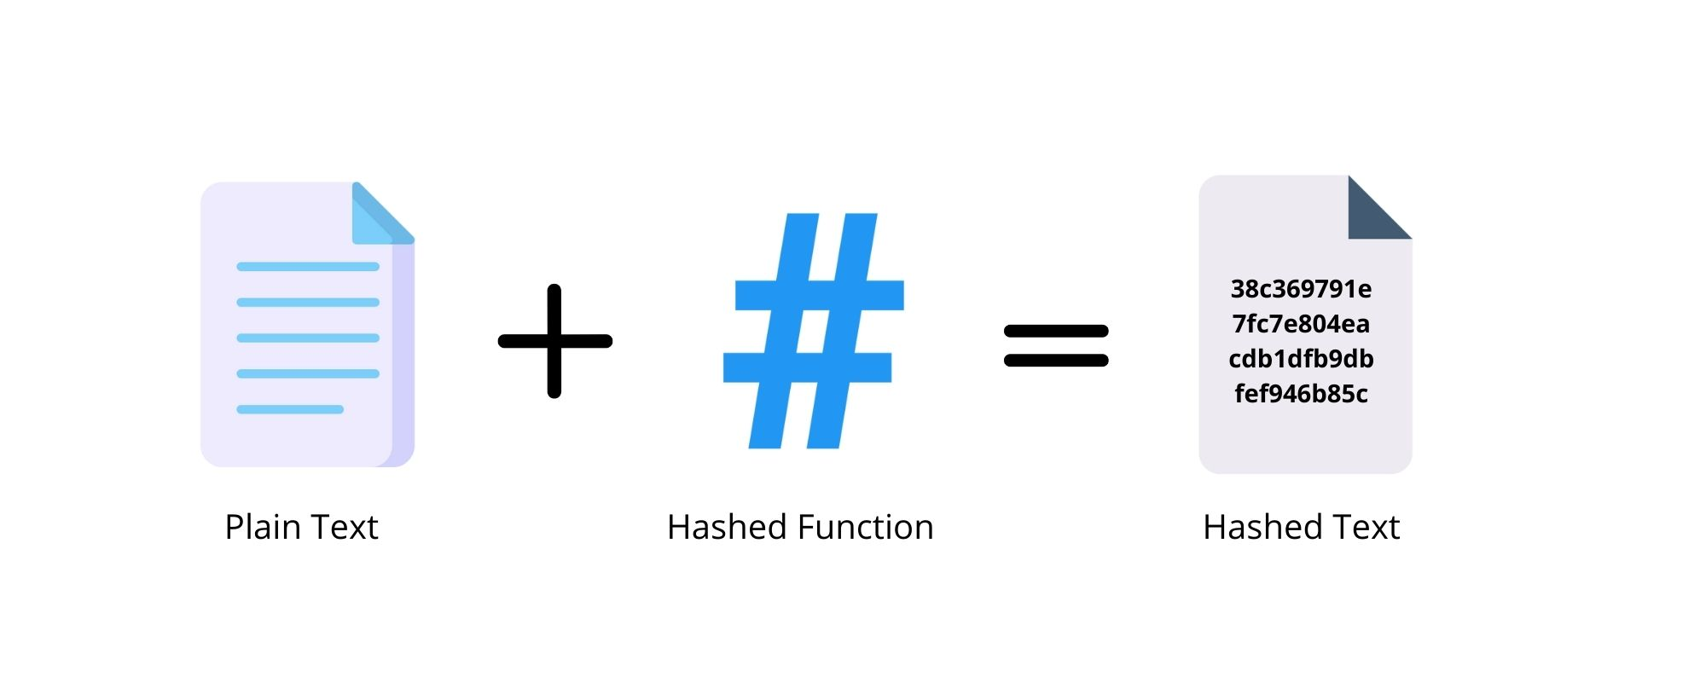

Hashes?
A hash is a way of taking a piece of data of any length and representing it in another fixed-length form
This process masks the original value of the data
This happens through hashing algorithms (MD5, SHA1, NTLM)
Take "Fort", a four-character string using MD5 it is "d611bfb203455185fe8254b27eaa73aa"
Now take "Fortnite", an 8-character string using MD5 it is "972b040498eb76771f064dd2c761edc9"

Slide 5
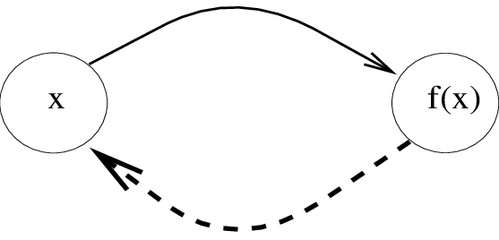
Why are they secure?
Hashes are one-way functions meaning if you have the input, it is easy to solve but without it is hard
They do this utilizing the modulo operator which is basically the remainder of a problem
16 mod 5 = 1
The modulo is not revisable, in the example you get 1 and that's great but there are infinite combinations to get that same number
So, to solve it you have to use brute force
This is where Hashcat comes in as a way to do a dictionary attack

Slide 6

What is Hashcat
What is it
Fast open-source password recovery tool
Used to crack passwords
How it works
It uses the GPU for fast cracking to process billions of password combinations
It supports over 450 different hash algorithms

Slide 7

Hashcat Installation/preparation
Windows
Go to Hashcat website
Download the top download option
Open File in CMD
Linux
sudo apt install hashcat
sudo dnf install hashcat
For the wordlist download from Github

Slide 8
Hashcat basics
Syntax
hashcat -m <hash_type> -a <attack_mode> hashfile wordlist
hashcat: invokes the Hashcat program
-m <hash_type>: specifie hash-type # format
-a <attack_mode>: specifies the attack mode
hashfile: the hash file
wordlist: the wordlist file
Hashcat -m 0 -a 0 hash.txt rockyou.txt
Python script
wget https://gitlab.com/kalilinux/packages/hash-identifier/-/raw/kali/master/hash-id.py
GitHub download
To run it use: python3 hash-id.py
Type the hash into the prompt and it will give you possible hashes that it could be

Slide 9
Hashcat basics
hashcat -m <hash_type> -a <attack_mode> hashfile wordlist
format: what type of hash it is (MD5, SHA1, NTLM, etc.)
MD5=0, SHA1=100, NTLM=1000
Set attack type to 0 for now
hashcat -m 0 -a 0 hash.txt rockyou.txt
Note
To find the number for -m go to example_hashes website
We will be using Games.txt for our wordlist and in the task1 folder we will using the Hash.txt
Find out what type of hash each one is in task1
Crack the hash
Check answers with me

Slide 10
Attack modes part 1
-a 0 = Dictionary Attack
Uses a wordlist to try passwords directly
hashcat -m 0 -a 0 hash.txt rockyou.txt
-a 1 = Combinator Attack
Combines words from two wordlist
hashcat -m 0 -a 1 left.txt right.txt
-a 3 = Brute-force/Mask Attack
Guess password based on patterns
hashcat -m 0 -a 3 hash.txt ?l?u?d?s
?l=lowercase letter, ?u=uppercase letter, ?d=digit, ?s=special character
Use –1 to definne special characters
Find out what type of hash it is in task2
Crack the hash
Check answers with me

Slide 11
Attack modes part 2
-a 6 = Hybrid Attack (Wordlist + Mask)
Appends patterns to words
hashcat -m 0 -a 6 hash.txt rockyou.txt ?d?d
-a 7 = Hybrid Attack (Mask + Wordlist)
Prepends patterns to words
hashcat -m 0 -a 7 hash.txt ?d?d rockyou.txt
Find out what type of hash it is in task3
Crack the hash
Check answers with me

Slide 12
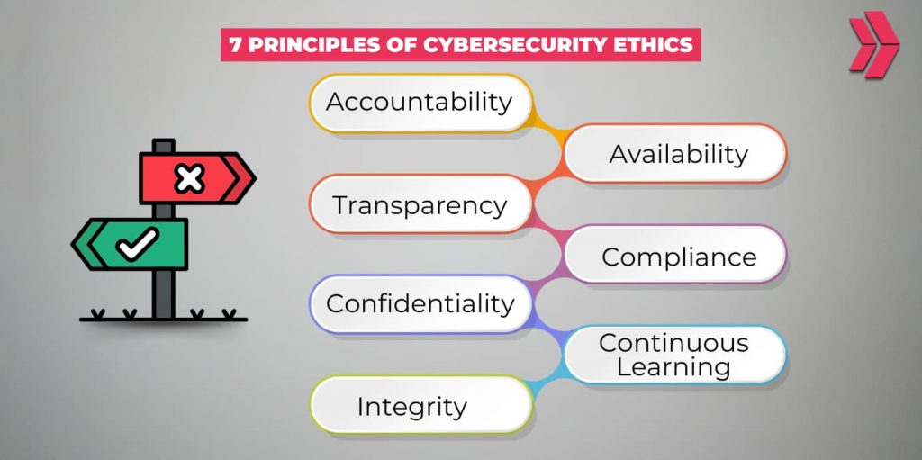
Ethics
Only crack your own hashes or authorized ones in labs, CTFs, or pen testing assignments
Help others identify weak passwords during an authorized pen test
Practice in offline labs environments
Use the rockyou.txt list by making hashes with echo -n “password” | md5sum
Always ask first before doing illegal stuff

Slide 13


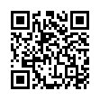
Social Media
Instagram
Discord
https://dsc.gg/bsucyber
Be Connected
(Attendance)

Slide 14

Questions

